Slide 1
Eelo University
Course: Management information
Class: Sophomore and Junior students
Lecturer: khadar

Slide 2
Learning Objectives
Explain why knowledge of information systems is important for business professionals and identify five key areas of information systems knowledge.
Give examples to illustrate how the business applications of information systems can support a firm’s business processes, managerial decision making, and strategies for competitive advantage.
Notes:
Why Information Systems Are Important – An understanding of the effective and responsible use and management of information systems and technologies is important for managers, business professionals, and other knowledge workers in today’s internetworked enterprises. Information systems play a vital role in the e-business and e-commerce operations, enterprise collaboration and management, and strategic success of businesses that must operate in an internetworked global environment. Thus, the field of information systems has become a major functional area of business administration.

Slide 3
Learning Objectives (Continued)
Provide examples of the components of real world information systems.
Provide examples of several major types of information systems.
Identify several challenges that a business manager might face in managing the successful and ethical development and use of information technology in a business.

Slide 4
Section I
Foundation Concepts:
Information Systems and Technologies
Notes:
Foundation Concepts: Foundations of Information in Business presents an overview of the five basic areas of information systems knowledge needed by business professionals, including the conceptual system components and major types of information systems.

Slide 5
What is management information system
A management information system (MIS) is a system or process that provides information needed to manage organizations effectively.
MIS is regarded to be a subset of the overall internal controls procedures in a business, which cover the application of people, documents, technologies, and procedures used by management accountants to solve business problems.

Slide 6
Cont..
MIS are distinct from regular information systems in that they are used to analyze other information systems applied in operational activities in the organization. Academically, the term is commonly used to refer to the group of information management methods tied to the automation or support of human decision making, e.g. decisions support system, expert system and executive information systems

Slide 7
Cont..
The terms MIS and information system are often confused. Information systems include systems that are not intended for decision making. The area of study called MIS is sometimes referred to, in a restrictive sense, as information technology management A management information system (MIS), or computer information systems (CIS), consists of five related components: hardware, software, people ,procedures, and collection of data

Slide 8
Information system
An information system can be any organized combination of people, hardware, communication networks, and the data resources that collects, transforms, and disseminates information in an organization

Slide 9
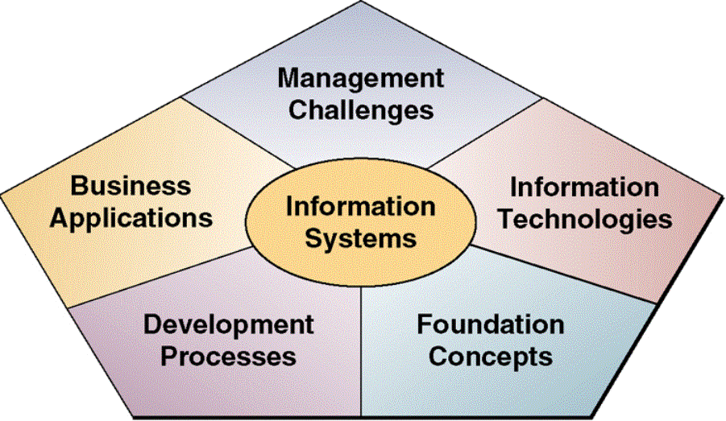
Information Systems Framework
Notes:
An IS Framework for Business Professionals – The IS knowledge that a business manager or professional needs to know is illustrated in the Figure. This include
foundation concepts: fundamental behavior, technical, business, and managerial concepts like system components and functions, or competitive strategies;
information technologies: concepts, developments, or management issues regarding hardware, software, data management, networks, and other technologies;
business applications: major uses of IT for business processes, operations, decision making, and strategic/competitive advantage;
development processes: how end users and IS specialists develop and implement business/IT solutions to problems and opportunities arising in business; and
management challenges: how to effectively and ethically manage the IS function and IT resources to achieve top performance and business value in support of the business strategies of the enterprise.

Slide 10

Information Systems Concepts (Continued)
Foundation Concepts
  Fundamental concepts about the components and roles of information systems.
Information Technologies
  Major concepts, developments, and management issues in information technology.

Slide 11
Information Systems Concepts (Continued)
Business Applications
  The major uses of information systems for operations, management, and competitive advantage of a business
Development Processes
  How business professionals and information specialists plan, develop, and implement information systems to meet business opportunities
Management Challenges
  The challenge of managing ethically and effectively.

Slide 12
What is a system?
A group of interrelated or interacting elements forming a unified whole, OR
A group of interrelated components working together toward a common goal by accepting inputs and producing outputs in an organized transformation process (dynamic system).
Three basic interacting components:
  Input
  Processing (transformation process)
  Output

Slide 13
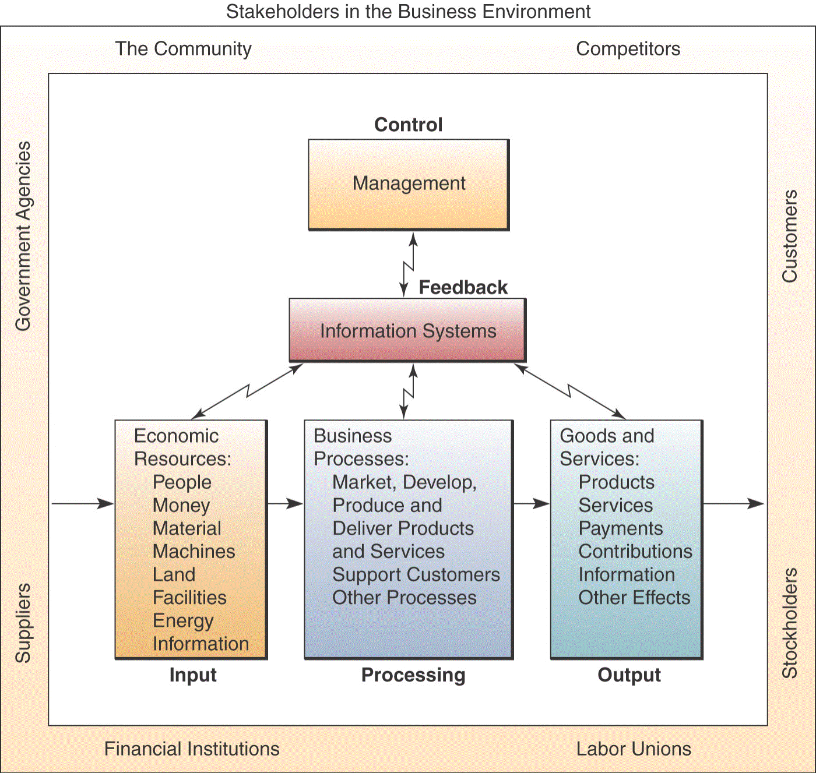
Add Feedback and Control Loops..
And the system, now called a cybernetic system, becomes even more useful.
  Self-monitoring
  Self-regulating
Notes:
Feedback and Control:
Two additional components of the system concept include feedback and control. A system with feedback and control components is sometimes called a cybernetic system, that is, a self-monitoring, self-regulating system.
• Feedback is data about the performance of a system.
• Control involves monitoring and evaluating feedback to determine whether a system is moving toward the achievement of its goals. The control function then makes necessary adjustments to a system's input and processing components to ensure that it produces proper output.

Slide 14
Other System Characteristics
note that a system does not exist in a vacuum ,rather, it exists and functions in an environment containing other systems.
Subsystem – a component of a larger system.
Systems that share the same environment may be connected to one another through a shared boundary, or interface.
Open versus closed system.
Adaptive system
Notes:
Other System Characteristics:
A system does not exist in a vacuum; rather, it exists and functions in an environment containing other systems.
Subsystem: A system that is a component of a larger system, where the larger system is its environment.
System Boundary: A system is separated from its environment and other systems by its system boundary.
Interface: Several systems may share the same environment. Some of these systems may be connected to one another by means of a shared boundary, or interface.
Open System: A system that interacts with other systems in its environment is called an open system (connected to its environment by exchanges of inputs and outputs).
Adaptive System: A system that has the ability to change itself or its environment in order to survive is called an adaptive system.

Slide 15
Other System Characteristics
open system: a system that interacts with other systems in its environment
Adaptive system ; a system that has the ability to exchange itself or its environment in order to survive is adaptive systems

Slide 16
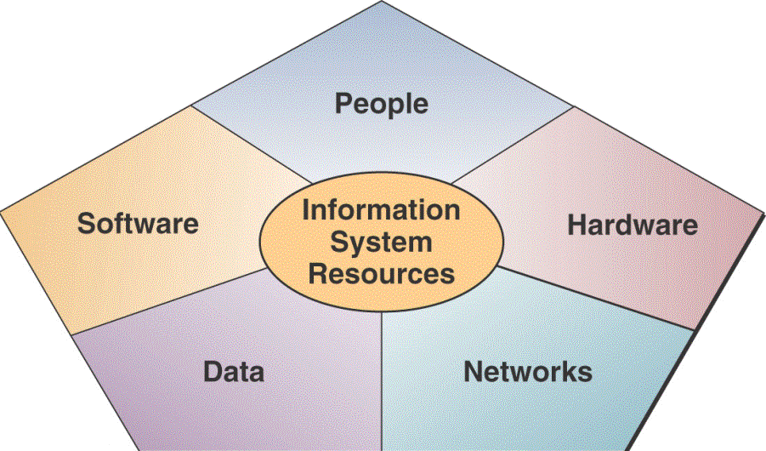
Components of an INFORMATION System
Notes:
An information system (IS) can be any organized combination of people, hardware, software, communications networks, and data resources that collect, transforms, and disseminate information in an organization.
Information Technologies:
Business professionals rely on many types of information systems that use a variety of information technologies. For example:
Types of IS - Manual (paper-and-pencil) information systems
- Informal (word-of-mouth) information systems
- Formal (written procedures) information systems
- Computer-based information systems
Computer-based information systems (IS) use hardware, software, the Internet, and other telecommunications networks, computer-based data resource management techniques, and other forms of information technologies (IT) to transform data resources into a variety of information products for consumers and business professionals.

Slide 17
Components of an Information System (Continued)
People Resources
  End Users
  IS Specialists
Hardware Resources
  Computer systems
  Peripherals
Software Resources
  System software
  Application software
  Procedures
Data Resources
  Data versus Information
Network Resources
  Communication media
  Network support

Slide 18
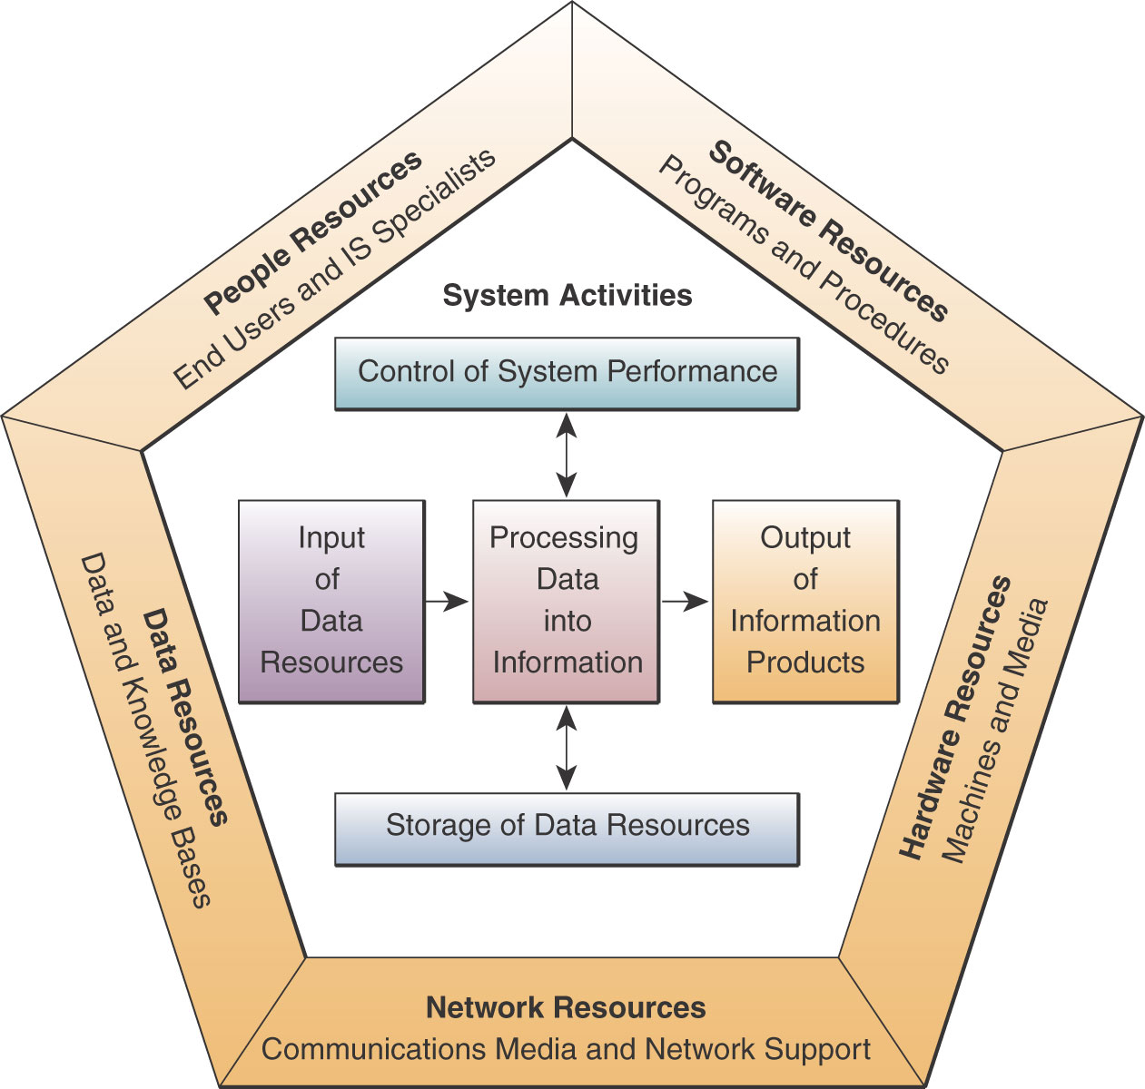
Components of an Information System (Continued)

Slide 19
Information system resources
People resource (End users and IS specialist )
Hardware resources( computer systems and Computer peripherals)
3. Software resources
System software
Application software
Procedure
4. Data resources
5. Network resources

Slide 20
Data Versus Information
Data are raw fact or observations that describe a particular phenomenon
People often use the terms data and information interchangeably. however, it is better to view data as raw material resources that are processed into finished information products. Then we can define information as data that have been converted into a meaningful and useful context for specific end users
Notes:
Data: - are raw facts or observations, typically about physical phenomena or business transactions. More specifically, data are objective measurements of the attributes (characteristics) of entities, such as people, places, things, and events.
Information: - is processed data, which has been placed in a meaningful and useful context for an end user. Data is subjected to a “value-added” process (data processing or information processing) where:
• Its form is aggregated, manipulated, and organized.
• Its content is analyzed and evaluated
• It is placed in a proper context for a human user

Slide 21
Information can be
Internal information: describes specific operational aspects of the organization
External information: describes the environment surrounding the organization
Objective information: quantifiably describes something that is known
Subjective information attempts to describe that is unknown

Slide 22
Information system activities
Input data resources
Processing of data into information
Output of information products
Storage of data resources
Control of system performances
Notes:
Input of Data Resources:
• Data about business transactions and other events must be captured and prepared for processing by the input activity. Input typically takes the form of data entry activities such as recording and editing.
• Once entered, data may be transferred onto a machine-readable medium such as magnetic disk or type, until needed for processing.
Processing of Data into Information:
• Data is typically subjected to processing activities such as calculating, comparing, sorting, classifying, and summarizing. These activities organize, analyze, and manipulate data, thus converting them into information for end users.
• A continual process of correcting and updating activities must maintain quality of data stored in an information system.
Output of Information Products:
• Information in various forms is transmitted to end-users and made available to them in the output activity. The goal of information systems is the production of appropriate information products for end users.
Storage of Data Resources:
Storage is a basic system component of information systems.
• Storage is the information system activity in which data and information are retained in an organized manner for later use.
Control of System Performance:
An important information system activity is the control of its performance.
• An information system should produce feedback about its input, processing, output, and storage activities.
• Feedback must be monitored and evaluated to determine if the system is meeting established performance standards.
• Feedback is used to make adjustments to system activities to correct deficiencies.

Slide 23
Section II
Foundation Concepts: Business Applications, Development, and Management

Slide 24
Major Roles of IS
Support
Competitive
Advantage
Support
Business
Decision Making
Support of
Business Processes and Operations
Notes:
Three major roles of the business applications of information systems include:
• Support Business Processes – involves dealing with information systems that support the business processes and operations in a business.
• Support Decision Making – help decision makers to make better decisions and attempt to gain a competitive advantage.
• Support Competitive Advantage – help decision makers to gain a strategic advantage over competitors requires innovative use of information technology.

Slide 25
The Present and the Future
E-Business
  The use of Internet technologies to internetwork and empower…
    Business processes
    Electronic commerce, and
    Enterprise communication & collaboration
  Within a company & with its customers, suppliers, & other business stakeholders.

Slide 26
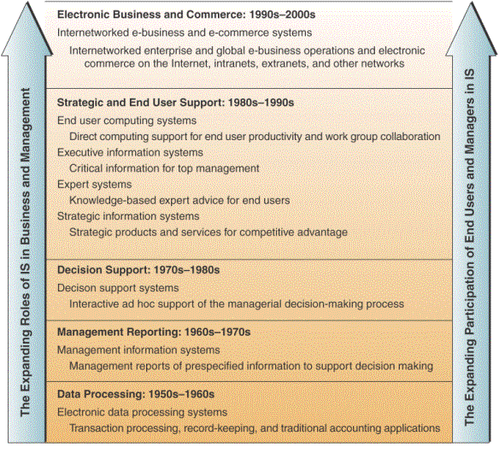
Trends in Information Systems
Notes:
The roles given to the information systems function have expanded significantly over the years.
1950s - 1960s - Data Processing - Electronic data processing systems
Role: Transaction processing, record keeping, and accounting, and other electronic data processing (EDP) applications
1960s - 1970s - Management Reporting – Management information systems
Role: Providing managerial end users with predefined management reports that would give managers the information they needed for decision-making purposes.
1970s - 1980s - Decision Support - Decision support systems
Role: The new role for information systems was to provide managerial end users with ad hoc support of their decision-making process. This support would be tailored to the unique decision-making styles of managers as they confronted specific types of problems in the real world.
1980s - 1990s - Strategic and End User Support
Role: End users could use their own computing resources to support their job requirements instead of waiting for the indirect support of corporate information services departments.
• End User Computing Systems
Role: Direct computing support for end user productivity and work group collaboration.
• Executive Information Systems (EIS) -
Role: These information systems attempt to give top executives an easy way to get the critical information they want, when they want it, tailored to the formats they prefer.
• Expert Systems (ES) and other Knowledge-Based Systems
Role: Expert systems can serve as consultants to users by providing expert advice in limited subject areas.
• Strategic Information Systems (SIS)
Role: Information technology becomes an integral component of business processes, products, and services that help a company gain a competitive advantage in the global marketplace.
1990s - 2000 – Electronic business and commerce systems
Role: The rapid growth of the Internet, intranets, extranets, and other interconnected global networks has revolutionising the operations and management of today’s business enterprises.

Slide 27
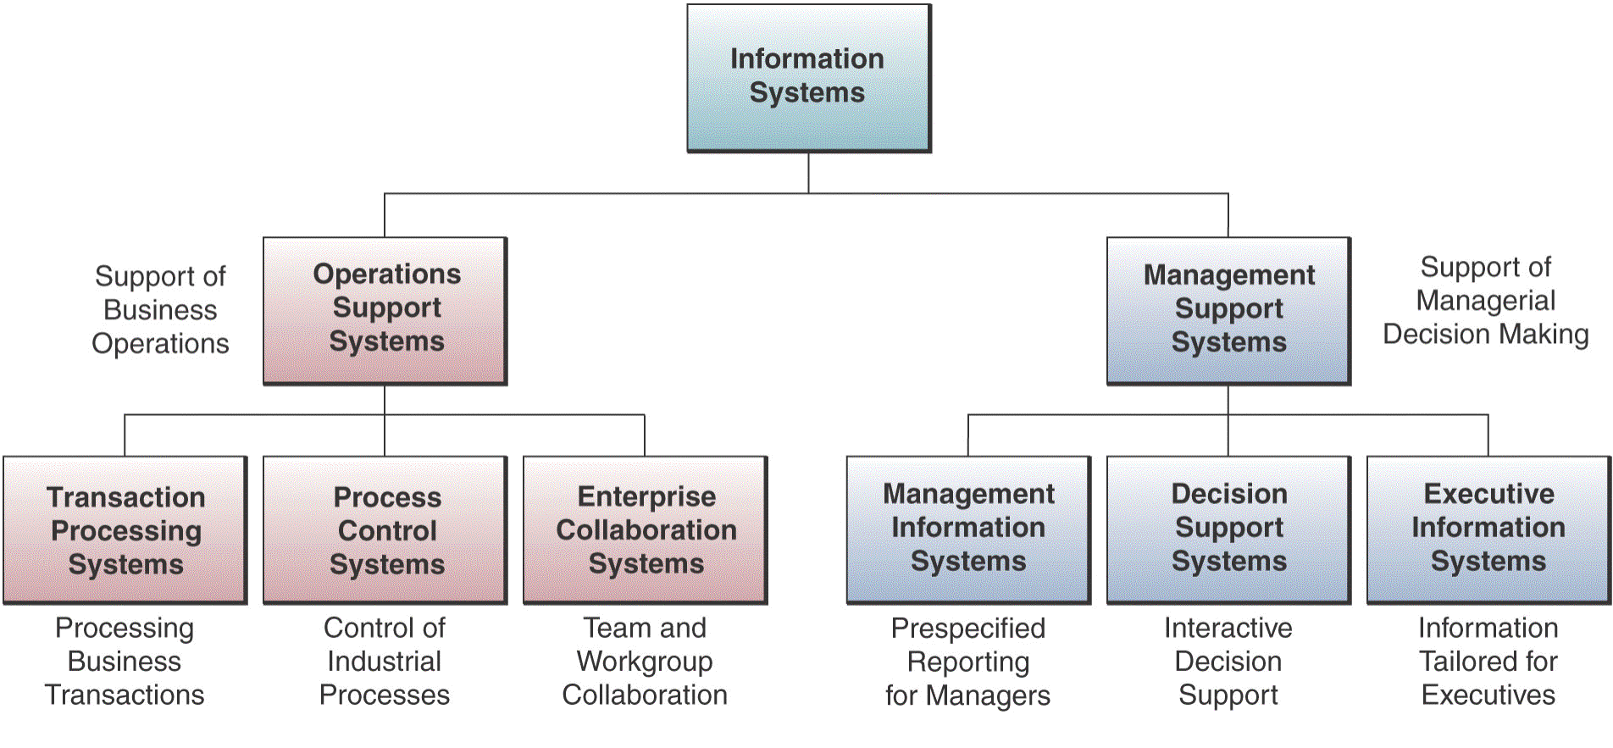
Types of Information Systems

Slide 28
Types of Information Systems
Operations Support Systems
  Transaction processing systems
    Batch – transaction data accumulate over time, processed periodically.
    Real-time – data processed immediately after a transaction occurs.
  Process Control Systems – monitor & control physical processes.
  Enterprise Collaboration Systems

Slide 29
Types of Information Systems (continued)
Management Support Systems
  Management Information Systems – pre-specified reports & displays to support decision-making.
  Decision Support Systems – provide interactive ad hoc support.
  Executive Information Systems – critical information tailored to the information needs of executives.

Slide 30
Types of Information Systems (continued)
Other Classifications
  Expert systems – expert advice
  Knowledge management systems – support the creation, organization, & dissemination of business knowledge
  Functional business systems – support the basic business functions
  Strategic information systems – strategic advantage

Slide 31
Managerial challenges of information technology
Information systems can be mismanaged and misapplied so that they create both technological and business failure.
Top Five Reasons for Success
Top Five Reasons for Failure
User involvement
Lack of user input
Executive management support
Incomplete requirements and specifications
Clear statement of requirements
Changing requirements and specifications
Proper planning
Lack of executive support
Realistic expectations
Technological incompetence

Slide 32
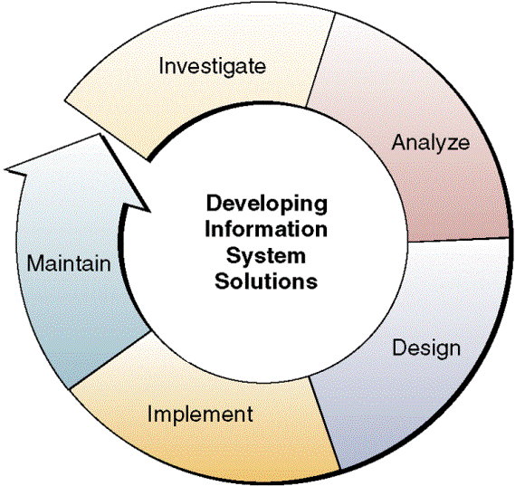
Developing IS Solutions to Business Challenges
Notes:
Developing successful information system solutions to business problems is a major challenge for business managers and professionals today. As a business professional, you will be responsible for proposing or developing new or improved use of information systems for your company. As a business manager, you will also frequently manage the development efforts of information systems specialists and other business end users.
Most computer-based information systems are conceived, designed, and implemented using some form of systematic development process. The Figure shows that:
• Several major activities must be accomplished and managed in a complete IS development cycle.
• In the development process, end users and information specialists design information system applications based on an analysis of the business requirements of an organization.
• Investigating the economic or technical feasibility of a proposed application.
• Acquiring and learning how to use the software required to implement the new system, and make improvements to maintain the business value of a system.

